Slide 1

Customer Churn Analysis
on
Telco Customer Churn Dataset
Prepared by:
Sahil Sawant | Atharva Shirwalkar
Mentored by: Prasad

Slide 2
About us:
Background ?
Atharva Shirwalkar: Bachelor of Engineering (Mechanical)
Sahil Sawant: Bachelor of Engineering (Mechanical)
Why did we want to learn Data Science?
As working professionals in the purchase and quality departments, we both had to deal with large amounts of data on daily basis.
Our profile required us to make data driven decisions for a smooth functionality of supply chain.
This hands-on exposure gradually ignited our interest in understanding how data could be leveraged more efficiently and intelligently.
These experiences helped us to find our passion in this profession.
Any work experience?
Atharva Shirwalkar: 1.5+ Years Experience as Quality Control Engineer
Sahil Sawant: 2+ Years Experience as Design and Purchase Engineer
Share your linkedin and github profile urls:
Atharva’s LinkedIN : https://www.linkedin.com/in/atharva-shirwalkar-5a5071350
Sahil’s LinkedIN : http://www.linkedin.com/in/sahil-sawant-0a13371b1/
Atharva’s GitHub: https://github.com/Atharva9912
Sahil’s GitHub: https://github.com/sawantsahil19

Slide 3
Project Overview:
This project analyzes customer churn patterns using the Telco Customer Churn dataset. The purpose of this project is to identify key churn drivers and revenue impact to support customer retention strategies.
This dataset includes:
Customer demographics
Tenure and Contract details
Internet and Add-on Services
Billing and Payment Methods
Churn status.
Objective:
To create an Interactive Power BI dashboard to make data-driven business decisions.

Slide 4
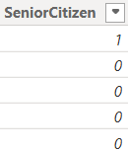
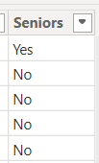
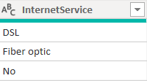
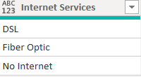
Data Preparation:
Before Conversion:
After Conversion:
1)
2)

Slide 5
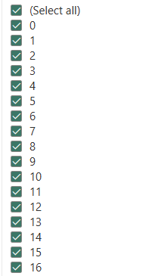
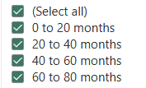
Before Conversion:
After Conversion:
3)
DAX Query Used:

Slide 6
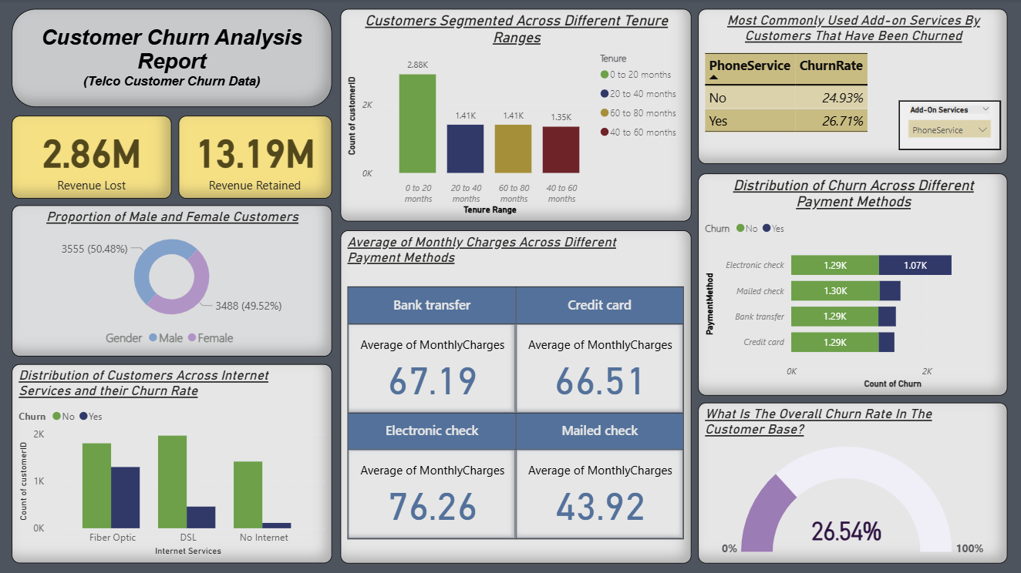
Key Visuals and Dashboard:

Slide 7
Insights and Key Findings:
26.54% of customers have churned, highlighting a retention concern.
$2.86M in revenue was lost due to churn and $13.19M was retained, which shows the revenue impact
Most customers are segmented in the 0-20 months tenure group, which also shows higher churn risk.
Gender is nearly balanced with 50.48% male population and 49.52% female.
Fiber Optic users have the highest churn while DSL users are more stable which suggests lower churn risk for the DSL category.
Churn is slightly higher among users with Phone Service (26.71%) compared to other services.
Electronic Check users have both the highest average monthly charges (₹76.26) and highest churn while Mailed Check users have the lowest monthly average charges (₹43.92) and relatively low churn.

Slide 8
Conclusion:
The churn analysis reveals that 26.54% of customers have left, causing a $2.86M revenue loss.
Churn is most common among new customers (0–20 months), Fiber Optic users, and those paying via Electronic Check.
Targeted retention strategies for these high-risk segments can significantly reduce churn and protect future revenue.
To reduce churn, focus should be on retaining new customers, improving service quality for fiber optic users, and promoting reliable payment methods like credit cards.
Enhancing Add-on services and collecting regular feedback can help identify at-risk customers early and improve overall retention.
Project URL:
https://app.powerbi.com/groups/me/reports/5d2ad7a5-3538-460d-9c54-4af497037f35/af20e66bb79201146e28?experience=power-bi

Slide 9

THANK YOU

